Slide 1
CSI2005 Principles of Compiler Design
MODULE – 2
Dr. WI. Sureshkumar
Associate Professor
School of Computer Science and Engineering (SCOPE)
VIT Vellore
wi.sureshkumar@vit.ac.in
SJT413A34

Slide 2
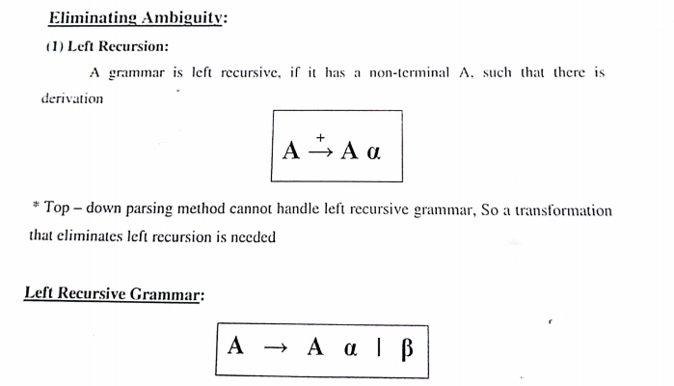
Left Recursion

Slide 3
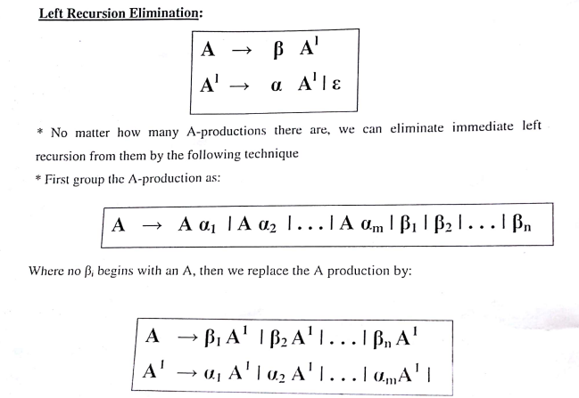
Left Recursion

Slide 4
Example -1
E → E + T / T
T → T * F / F
F → ( E ) / id
Eliminate the immediate left recursion,
E → TE’
E’ → +TE’ / ε
T → FT’
T’ → *FT’ / ε
F → ( E ) / id

Slide 5
Example -2
S → Aa / b
A → Ac / Sd / ε
Here both S and A are left recursive,
S Aa Sda
Since S is not immediate left recursive, keep S- productions as it is. Use the S-production in A-productions,
A → Ac / Aad / bd /ε
Now eliminate left recursion in A-productions,
A → bdA’ / A’
A’ → cA’ / adA’ / ε S → Aa / b

Slide 6
Problem
Eliminate left-recursion from the following grammar,
S → ( L ) / a
L → L , S / S
S → ( L ) / a
L → SL’
L’ →, SL’ / ε

Slide 7
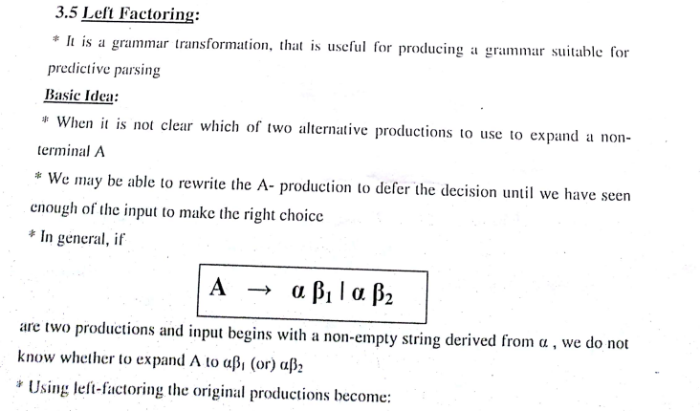
Left factoring

Slide 8
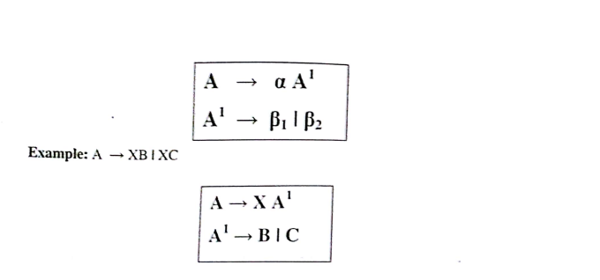
Left factoring

Slide 9
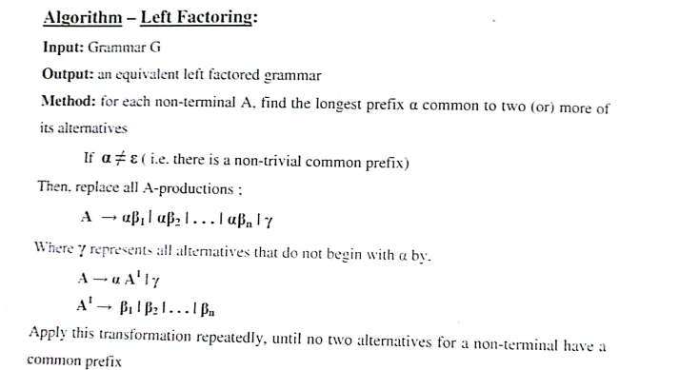
Left factoring

